Slide 1

Ch 8: Mobile Development Security
CNIT 128:
Hacking Mobile Devices

Slide 2
App Security Constraints
Built-in security features of the mobile platform
Possibility of device theft

Slide 3
Mobile App Threat Modeling

Slide 4
Threat Modeling
A pencil-and-paper exercise
Identifying security risks
Helps developer identify most critical risks
Focus on features and/or controls to mitigate those risks
The alternative is endless, aimless, bug-squashing

Slide 5

Threat Modeling Technologies
Microsoft Threat Modeling
  From 1999 (link Ch 8a)
Trike
  Open-source, began in 2006 (link Ch 8b)
  More traditional risk management philosophy

Slide 6
Threat Modeling Technologies
OCTAVE (Operationally Critical Threat, Asset, and Vulnerability Evaluation)
  From CERT (link Ch 8c)
Cigital Threat Modeling
  Based on software architecture (link Ch 8d)
P.A.S.T.A. (Process for Attack Simulation and Threat Analysis)

Slide 7
Similar Approach
Diagram the app
Understand where information assets flow
Document risks to the assets and security controls
Rank the risks by probability and impact
Remediate and verify highest-scored risks

Slide 8
Example: Adding a Mobile Client to an Existing Web App
New client will support end users and Customer Support Representatives (CSRs)
How do existing threats change when a mobile app is added?
  Enumerate threats
  Outline assets mobile devices possess
  Discuss how the mobile tech stacks create opportunities for threats

Slide 9
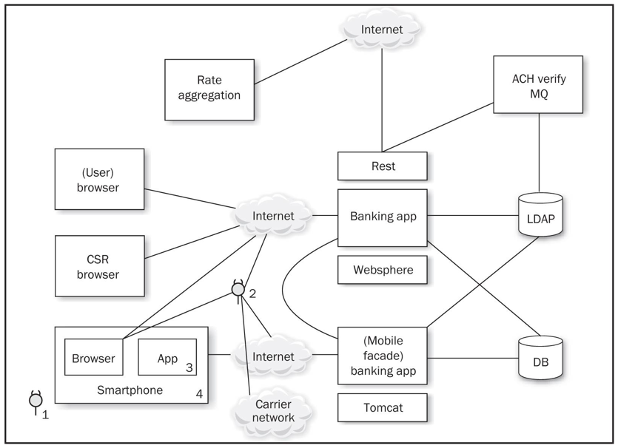

Slide 10
Threats
Web app hacking tools
Bluetooth and 801.22 attacks
Injecting code into a mobile browser
  Man-in-The-Browser (MiTB)
Malicious apps
  Malware and Trojans
Femtocells
  Observe all traffic

Slide 11
Threats from Phone's User
Download your app and reverse-engineer it
Jailbreak the device, subverting controls you depend on
Thieves may steal the device and gain access to the UI and physical interfaces such as USB

Slide 12
1. Users as Threats
What evil or insidious things could a user do?
  Steal encryption keys or credentials from apps
  Reverse-engineer apps
What obnoxious or stupid things could a user do to cause trouble?

Slide 13
Other Device "Owners" as Threats
Other stakeholders
  App store account owner
  App publisher, who provides the user experience and access to mobile services
  Mobile carrier, e.g. AT&T
  Device manufacturer: Samsung, etc.
  App store curator: Apple, Google, Amazon, etc.
  Company's IT dept. that administers the device

Slide 14
Importance of Other Stakeholders
Operate apps and underlying software
Control credentials
Operate services
Carriers and handset manufacturers place apps on the device
  May customize the OS
  May place code beneath the OS in firmware

Slide 15
Importance of Other Stakeholders
App store curators control a large portion of the app lifecycle
  Packaging and deployment
  Update and removal
When stakeholder goals differ
  Opportunity for one "owner" to do something that another stakeholder considers a violation of security or privacy
  Like collecting and storing personal information

Slide 16
Assets
Each stakeholder protects its assets
End-users may value privacy
App publisher and carrier want to collect and use personal and usage information

Slide 17
Types of Data
Offline access
  Available when phone is not connected to a network
Personal data
  Contacts, voicemails
Sensor-based data
  Location data (GPS and tower telemetry)
  Camera and microphone data

Slide 18
Identity Data
App publishers are reluctant to force users to authenticate using small virtual keyboards
Identity data includes
  Persistent credentials
  Bearer tokens (such as OAuth)
  Usernames
  Device-, user-, or application-specific UUIDs

Slide 19
Usernames
If a web-based service uses a mobile device for "out-of-band" password reset
And a user has an app for that service
Attacker with a stolen phone can reset the password

Slide 20
Threat Modeling
Derive the attack surface and potential attacks
  List assets and stakeholders
  Brainstorm how each stakeholder might cause a security or privacy breach for another
Prioritize attacks by likelihood and impact
Implement mitigations
Use the list of attacks to drive Secure Software Development Lifecycle

Slide 21
Secure Mobile Development Guidance

Slide 22
Threat modeling
Mobile app has two main components
  Mobile client
  Mobile Web services that support it
Both can be attacked

Slide 23
Native APIs or Mobile Web?
Apps written specifically for the platform, using native APIs
  Take full advantage of the platform's features
  User interface consistent with platform
Mobile Web apps
  Same as web app, but optimized for a smaller screen
Cross-platform mobile development frameworks try to provide the best of both worlds

Slide 24
Device and Runtime Environment Integrity
How can an app ensure that the OS hasn't been modified?
  Or even the app itself?
Mobile Device Management
  Provides some assurance
App integrity protection
  Anti-debugging and code obfuscation

Slide 25
Limitations of Integrity Assurance
If device is jailbroken or rooted
  Environment can lie about what's happening
Mobile Application Management (MAM)
  Some provide private app stores
  For closed-loop provisioning, patching, uninstallation, monitoring, and remote data wipe
Maintaining/Patching your App
  The app store is the main channel for updates

Slide 26
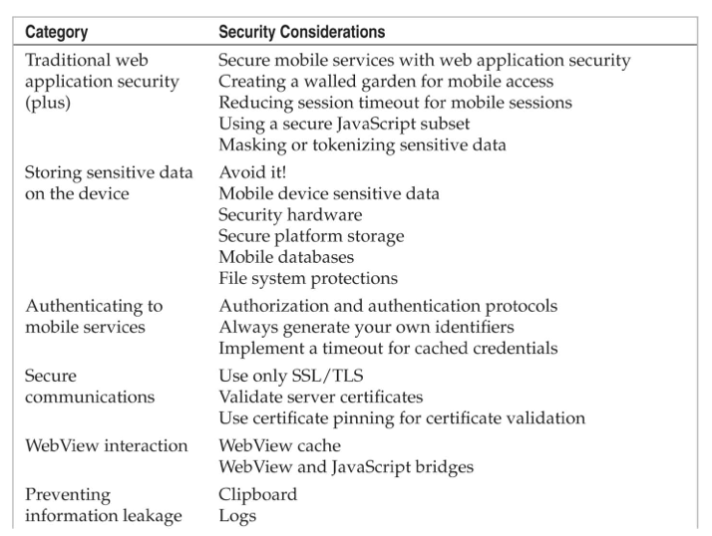
Secure Mobile App Guidelines

Slide 27
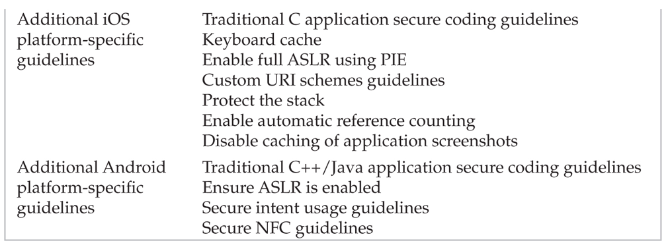
Secure Mobile App Guidelines

Slide 28
Secure Mobile App Guidelines
Web app security
  OWASP Top Ten
Create a walled garden
  Requests to Web app should parse the user-agent string
  Redirect traffic to mobile interfaces/services
  Don't serve mobile apps same content as computers
  Legacy content may be aggressively cached by mobile browsers

Slide 29
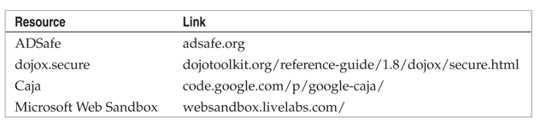
Secure Mobile App Guidelines
Reduce session timeout for mobile devices
  Greater risk of MiTM attacks
  Greater risk of device theft
Use a secure JavaScript subset
  Remove eval(), square brackets, "this"
  Secure JavaScript subsets:

Slide 30
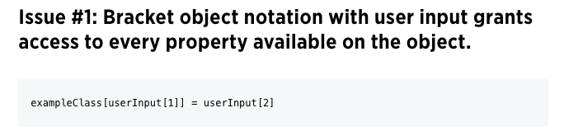
The Dangers of Square Bracket Notation
It can even lead to remote code execution
  Link Ch 8f

Slide 31
Secure Mobile App Guidelines
Mask or Tokenize Sensitive Data
  Mobile devices have aggressive data caching
  Increased risk of data exposure
  Replace sensitive data with an alternate representation "mask" or "token"

Slide 32
Secure Mobile App Guidelines
Storing sensitive data on the device
  Avoid storing sensitive data when possible
  Places to store data, strongest to weakest
    Security hardware
    Secure platform storage
    Mobile databases
    File system

Slide 33
Mobile Device Sensitive Data
Personal data
  Contacts, pictures, call data, voicemails, etc.
Sensor-based data
  GPS, camera, microphone
Identity data
  Persistent credentials
  Bearer tokens (like OAuth)
  Usernames
  Device-, user-, or application-specific UUIDs

Slide 34
Security Hardware
Secure Element (SE) microprocessor
  Used for mobile payment systems
  Accessed using existing smartcard standards
    ISO 7816 (contact)
    ISO 14443 (contactless)
  Considered fairly secure
  Locks out after 5 to 10 failed PIN attempts
    When used for a virtual wallet
  BUT general-purpose apps don't have access to the SE

Slide 35


ISO 14443: MIFARE
Used by BART and Boston T system
MIFARE Classic used a 48-bit key
Several vulnerabilities have been found

Slide 36

Link Ch 8k

Slide 37
Secure Platform Storage
Apple's keychain
  SQLite database
  Protected by an OS service that limits access
  Keychain items can only be accessed by the app that stored them
    And other apps from the same developer
    BUT root user can read the keychain

Slide 38
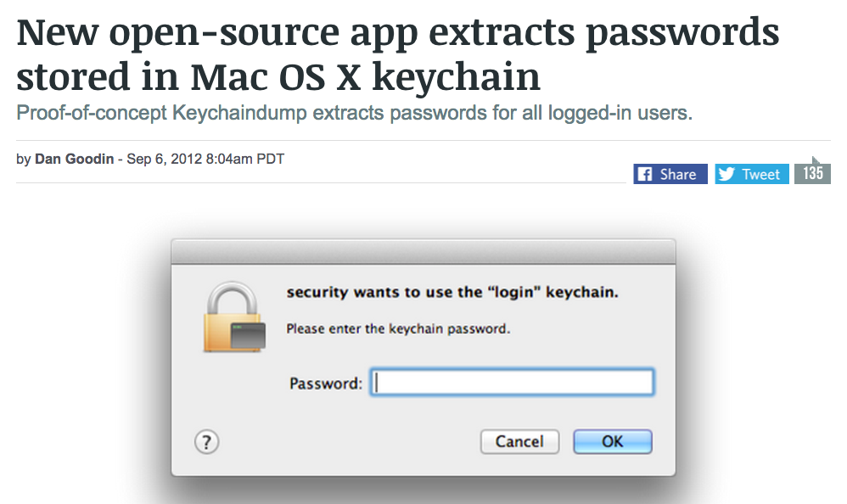
Keychain Weakness
Root user can read everything in the keychain
  Link Ch 8l

Slide 39
Android KeyStore
Intended to store cryptographic keys
Has no inherent protection mechanism such as a password
Apps must provide a mechanism like this to protect sensitive information;
  Password from user
  Use Password-Based Key Derivation Function 2 (PBKDF2) to generate an AES key
  Encrypt data with AES

Slide 40
Mobile Databases
Database can be encrypted with a single secret with third-party extensions to SQLite
  SEE, SQLCipher, CEROD
Apparently innocent data may expose personal identity
  Such as images
SQL injection attacks are possible
  Via intents or network traffic
  So use parameterized queries

Slide 41
File System Protections in iOS
Default encryption of files on the data partition
Centrally erasable metadata
Cryptographic linking to a specific device, so files moved from one device to another are unreadable without the key
Enabled by default in iOS 5 and above
Apple's iOS Security White Paper (link Ch 8m)

Slide 42
File System Protections in Android
Files stored in internal storage are private to the app that created them
  Unless the app changes the default Linux file permissions or uses MODE_WORLD_WRITEABLE or MODE_WORLD_READABLE
Files stored in external storage (such as SD cards) are accessible to all applications
Android 3.0 and later provides file-system encryption

Slide 43
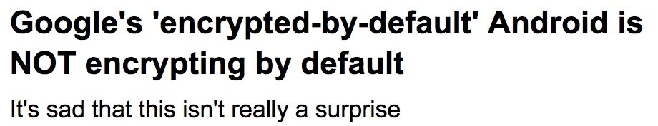
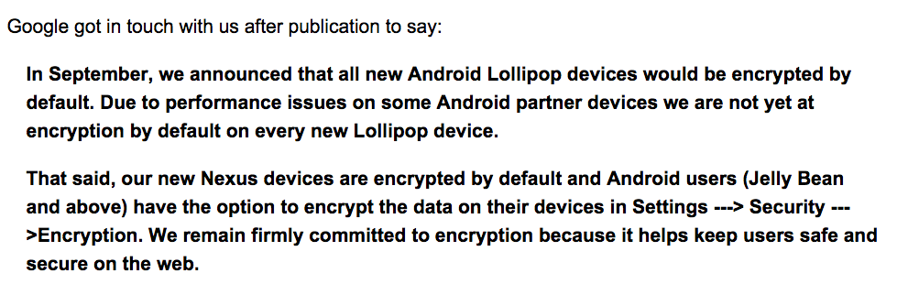
From March 2, 2015
  Link Ch 8o

Slide 44
Authenticating to Mobile Services
As previously covered, OAuth and SAML make it possible to avoid storing or using a password in your mobile app
  As if any developers cared...

Slide 45
Always Generate Your Own Identifiers
Apps have used existing identifiers like
  IMEI number, MAC address, phone number, etc.
To identify users and devices
But what happens when a device is stolen or sold?
Also such identifiers often lack secrecy and entropy
  Phone number is often publicly listed on Facebook, etc.

Slide 46
More Recommendations
Implement a Timeout for Cached Credentials
  Good for security but inconvenient
  Rarely done
Secure Communications
  Use Only TLS
  Direct HTTPS communications resist man-in-the-middle attacks including sslstrip
Validate Server Certificates

Slide 47
Use Certificate Pinning for Validating Certificates
Adds another step to verifying a server certificate
Compares the certificate to a trusted copy of the certificate included in the app
Exploits the special relationship between the app and the server
The app can be more secure than a Web browser because it knows which server it should be connecting to

Slide 48
WebView Interaction
WebView Cache Threats
  May contain sensitive web form and authentication pages
  If a user chooses to save credentials in the browser, they are in the cache
  WebView cookies database could be used to hijack sessions with banks and other websites

Slide 49
WebView Interaction
WebView Cache Mitigations
  Disable autocomplete on all sensitive form inputs
  Set no-cache HTTP header on server
  WebView object on the client side can be set to never save authentication data and form data
  Use clearCache() method to delete files stored locally on the device
  On Android, you must delete files explicitly because clearCache() doesn't erase them all

Slide 50
WebView Interaction
WebView Cache Mitigations
  To reduce the risk from cached cookies, set up a session timeout on the server
  Cookies should never be set to persist for a long time
  To clear cookies on the client, use the CookieManager or the NSHTTPCookieStorage classes
  On iOS, use NSURLCache to remove cached responses

Slide 51
WebView and JavaScript Bridges
On Android, protect against reflection-based attacks by targeting API 17 or above
On older devices:
  Only use addJavaScriptInterface if really needed
  Develop a custom JavaScript bridge with shouldOverrideUrlLoading
  Reconsider why you need a bridge and remove it if feasible

Slide 52
WebView Countermeasures
If an app uses a custom URI scheme
  Be careful what functionality is exposed
  Use input validation and output encoding to prevent injection attacks

Slide 53
Preventing Information Leakage
Clipboard
  Android and iOS support copy-and-paste
  Access to clipboard is fairly unrestricted
  Take explicit precautions to avoid sensitive data entering the clipboard
  On Android, cell setLongClickable(false) on a field
  On iOS, subclass UITextView to disable copy/paste

Slide 54
Preventing Information Leakage
Logs
  Watch for sensitive data in system and debug logs
  Or the device driver dmesg buffer
  Any Android app with the READ_LOGS permission can view the system log
  On iOS, disable NSLog statements
  X:Y coordinate buffers can expose PINs or passwords

Slide 55
iOS-Specific Guidelines

Slide 56
iOS-Specific Guidelines
Keyboard cache
  MDMs can add an enterprise policy to clear the keyboard dictionary at regular intervals
  Users can do this with Settings, General, Reset, "Reset Keyboard Dictionary"
Enable full ASLR
  Usually on by default
  Sometimes developer must explicitly code for it

Slide 57
iOS-Specific Guidelines
Custom URI Scheme Guidelines
  Use openURL instead of the deprecated handleOpenURL
  Validate the sourceApplication parameter to restrict access to the custom URI to a specific set of applications
  Validate the URL parameter; assume it contains malicious input

Slide 58
iOS-Specific Guidelines
Protect the stack
  With gcc, use –fstack-protector-all to enable Stack Smashing Protection (SSP)
  Apple LLVM compiler automatically enables SSP
Enable automatic reference counting
  Automatically manages memory for Objective-C objects and blocks
  Reduces chance of use-after-free vulnerabilities
  And other C memory-allocation problems

Slide 59
iOS-Specific Guidelines
Disable caching of application screenshots
  iOS captures the screen when an app is suspended
  Such as when user clicks the Home button or the Sleep/Wake button
  Or the system launches another app
  It does this to show transition animations
  This could capture sensitive data
  Prevent this by specifying a splash screen to display upon entering the background

Slide 60
Android-Specific Guidelines

Slide 61
Android-Specific Guidelines
Traditional C++/Java secure coding
  Google recommends using Java rather than C++; it's more secure
Ensure ASLR is Enabled
  C and C++ must be compiled and linked with PIE

Slide 62
Secure Intent Usage
Public components should not trust data received from intents
Perform input validation on all data from intents
Use explicit intents where possible
Only export components if necessary
Create a custom signature-protection-level permission to control access to implicit intents
Use a permission to limit receivers of broadcast intents
Don't put sensitive data in broadcast intents

Slide 63
Android-Specific Guidelines
Secure NFC guidelines
  Don't trust data from NFC tags
  Perform input validation
  Write-protect a tag before it is used to prevent it from being overwritten
Test your controls
  Make sure every setting is really working

